Slide 1
19CSE435: Computer Vision
Introduction to epipolar geometry and stereo

Slide 2
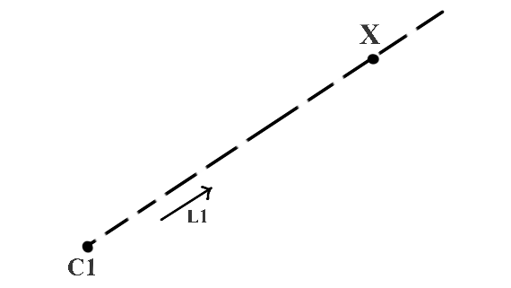
Introduction- Motivation
When we capture (project) a 3D object in an image, we are projecting it from a 3D space to a 2D (planar) projective space. This is called the Planar Projection. The problem is that we lose the depth information due to this planar projection.
C1 and X are points in 3D space, and the unit vector L1 gives the direction of the ray from C1 through X.
as the value of k is not known, we cannot find a unique value of X

Slide 3
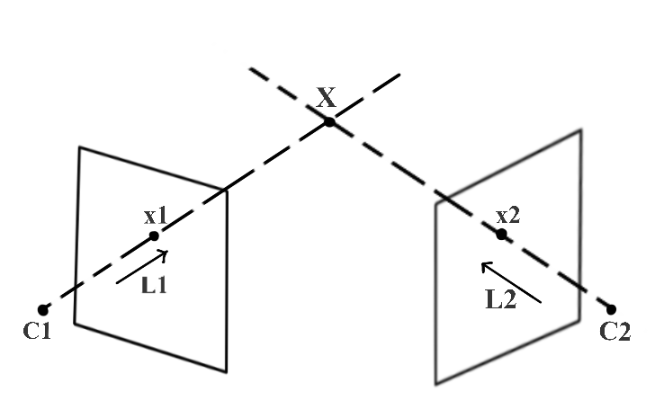
Triangulation
an additional point C2, and L2 is the direction vector of the ray from C2 through X.
We can find a unique value for X if C2 and L2 are also known
the rays originating from C1 and C2 clearly intersect at a unique point, point X itself. This is called triangulation. we triangulated point X
triangulation can be used to calculate the depth of a point (X) when captured(projected) in two different views(images)
→ C1 and C2 are known 3D positions of the left and right cameras, respectively.
x1 is the image of the 3D point X captured by the left camera, and x2 is the image of X captured by the right camera. x1 and x2 are called corresponding points because they are the projection of the same 3D point
use x1 and C1 to find L1 and x2 and C2 to find L2.
an use triangulation to find X

Slide 4

triangulation
to triangulate a 3D point using two images capturing it from different views, the key requirements are:
Position of the cameras – C1 and C2.
Point correspondence – x1 and x2.
we calculate a 3D structure of a real-world scene by capturing it from two different views
repeat the process for all the 3D points captured in both the views

Slide 5
3D Structure
To calculate the 3D structure, we try to find the two key requirements
→The position of cameras in the real world coordinate system (C1 and C2). We simplify this problem by calculating the 3D points by assuming one of the camera positions (C1 or C2) as the origin. We find it by calibrating the two view system using a known calibration pattern. This process is called stereo calibration.
→The point correspondence (x1 and x2) for each 3D point (X) in the scene to be calculated. epipolar geometry can help us to simplify the problem
One method which people regularly use in the computer vision community is called feature matching

Slide 6
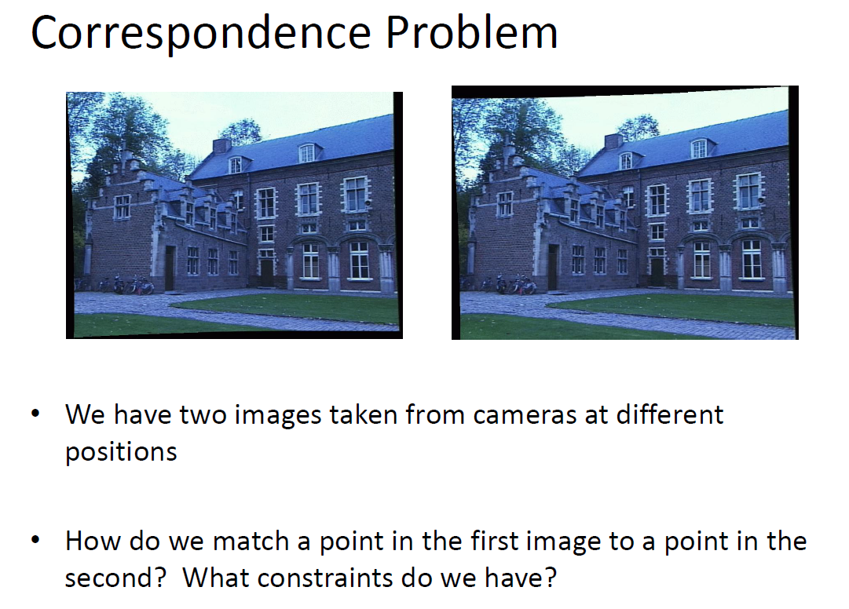

Slide 7
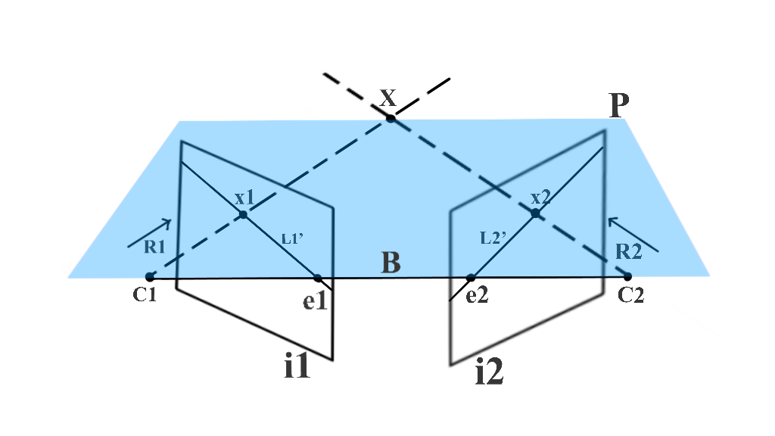
Epipolar Geometry
A 3D point X is captured at x1 and x2 by cameras at C1 and C2, respectively.
As x1 is the projection of X, If we try to extend a ray R1 from C1 that passes through x1, it should also pass through X. This ray R1 is captured as line L2, and X is captured as x2 in the image i2. As X lies on R1, x2 should lie on L2. This way, the possible location of x2 is constrained to a single line, and hence we can say that the search space for a pixel in image i2, corresponding to pixel x1, is reduced to a single line L2. We use epipolar geometry to find L2.

Slide 8
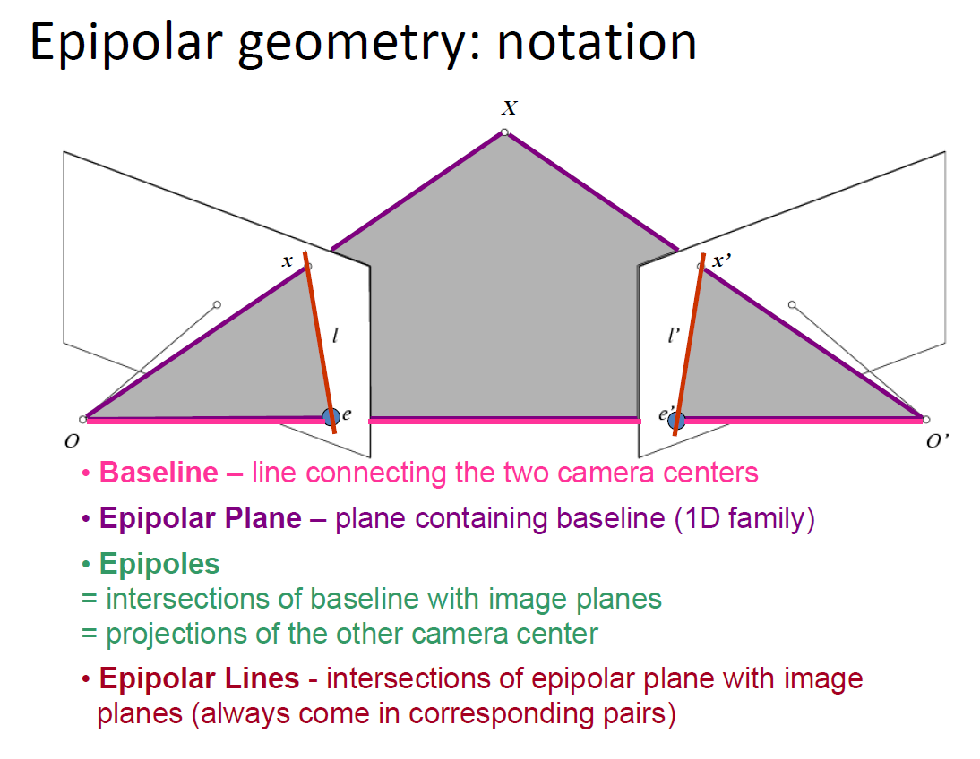

Slide 9
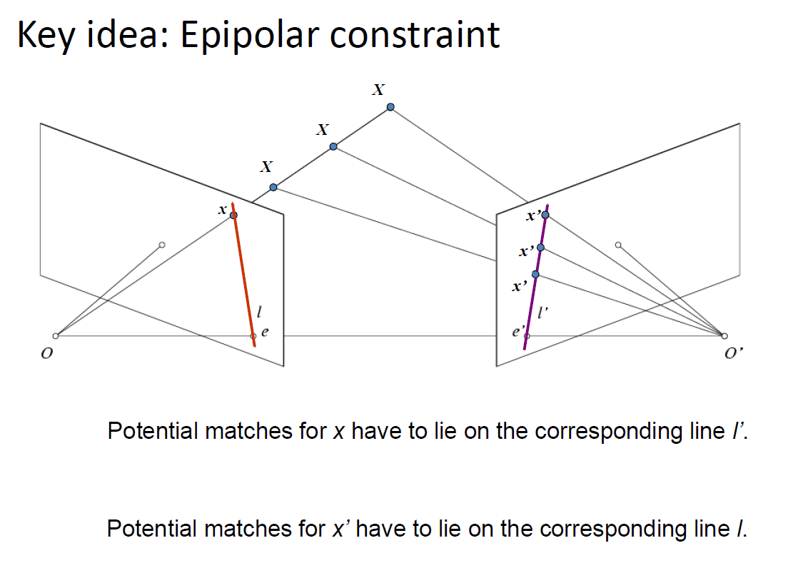

Slide 10
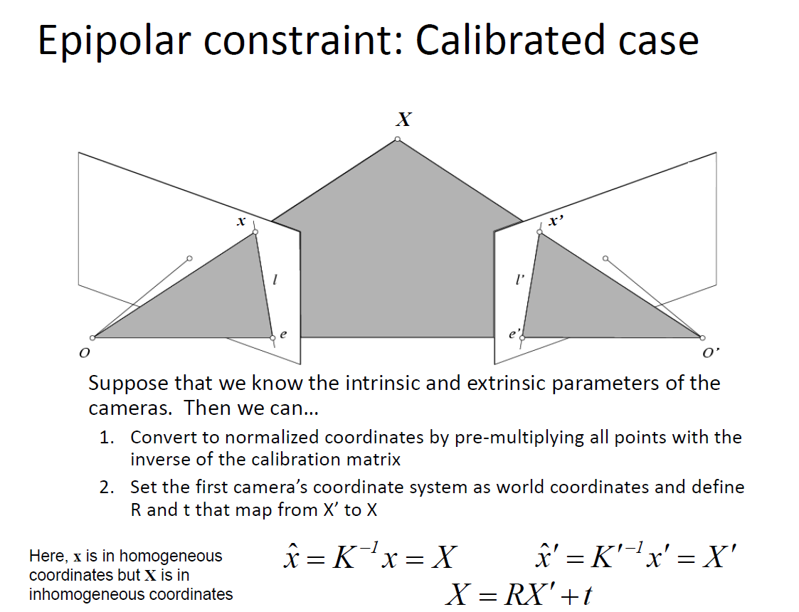

Slide 11
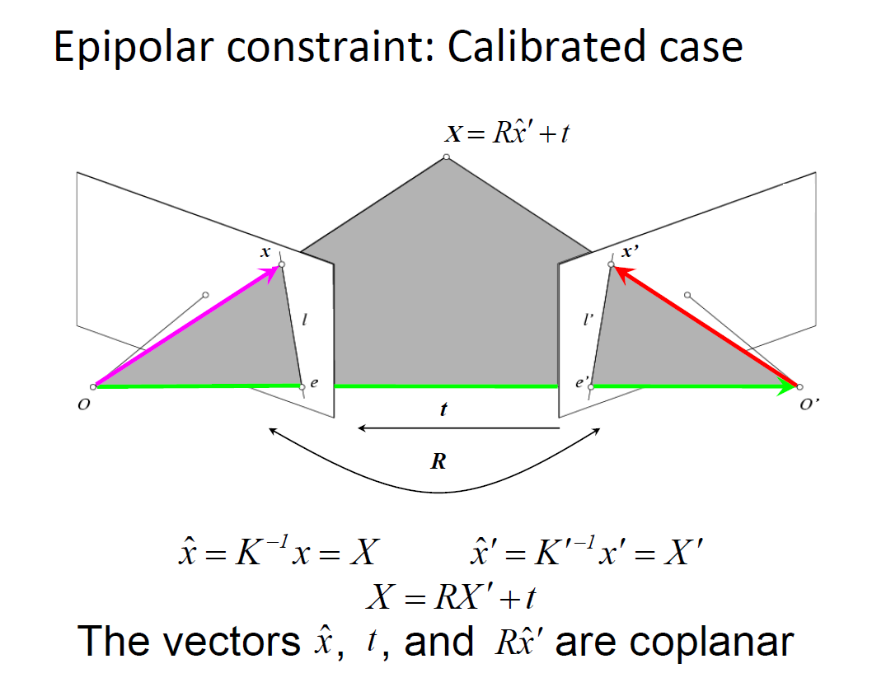

Slide 12
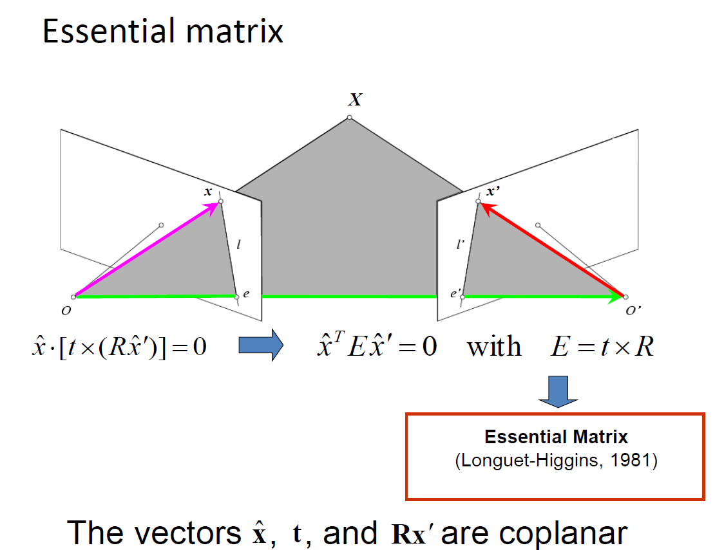

Slide 13
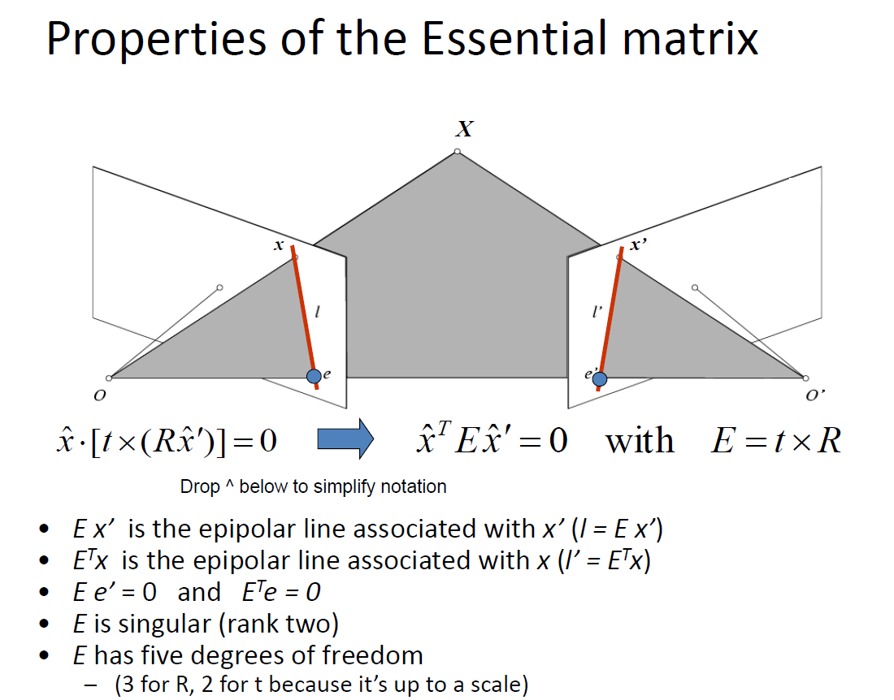

Slide 14
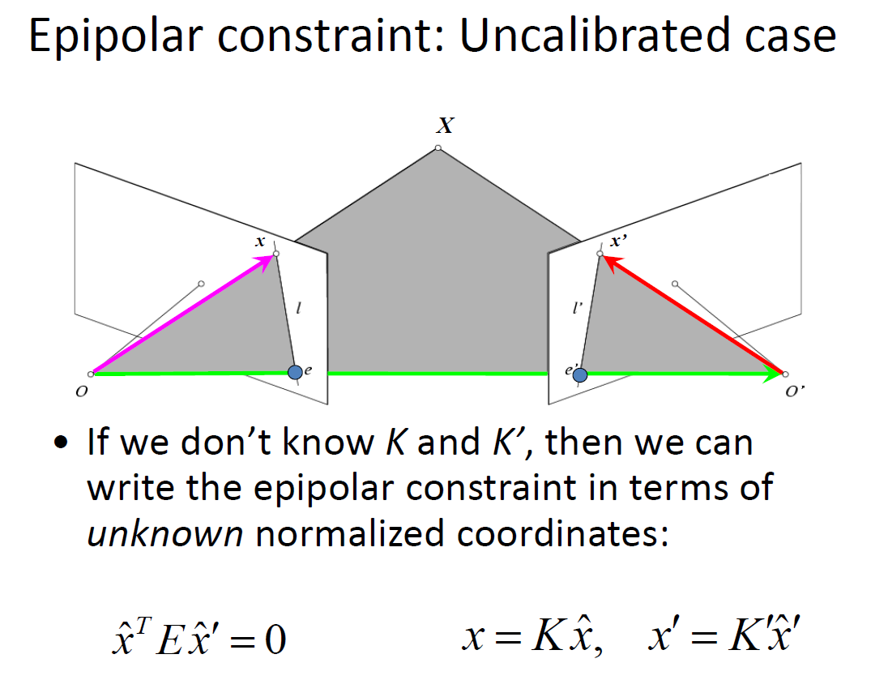

Slide 15
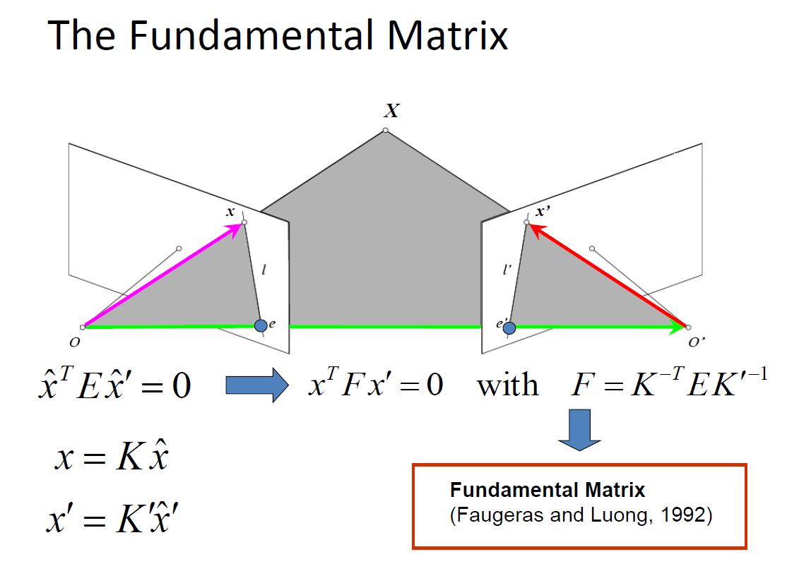

Slide 16
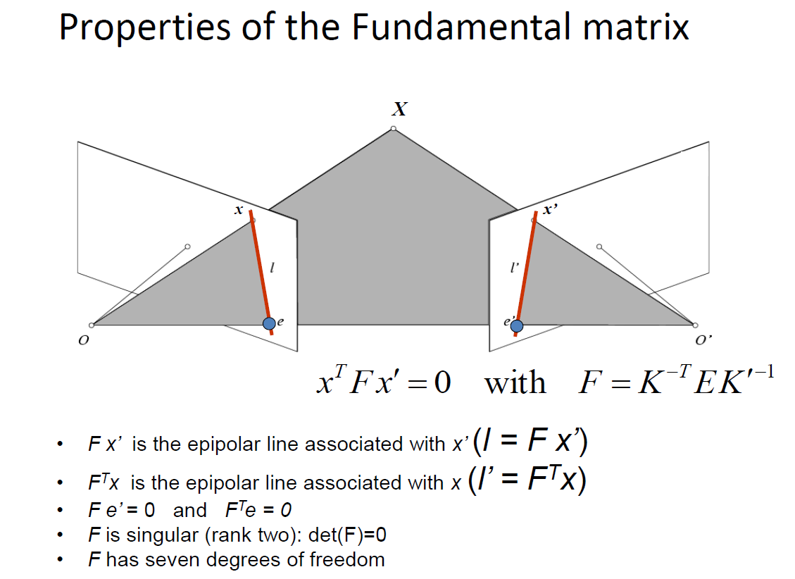

Slide 17
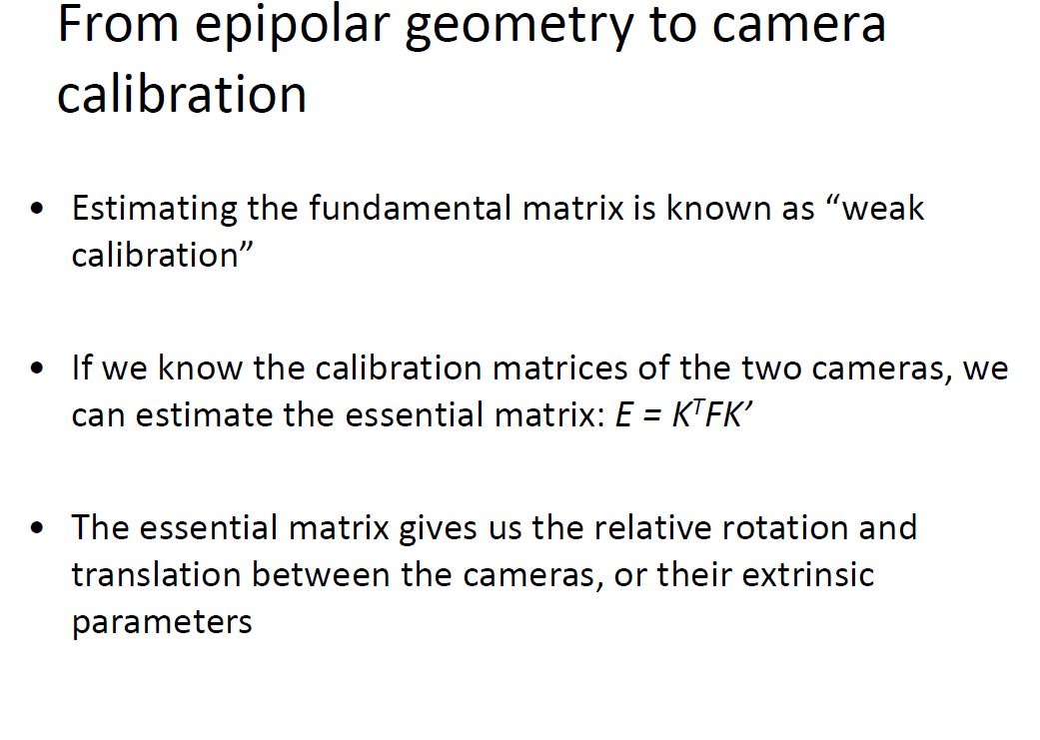

Slide 18
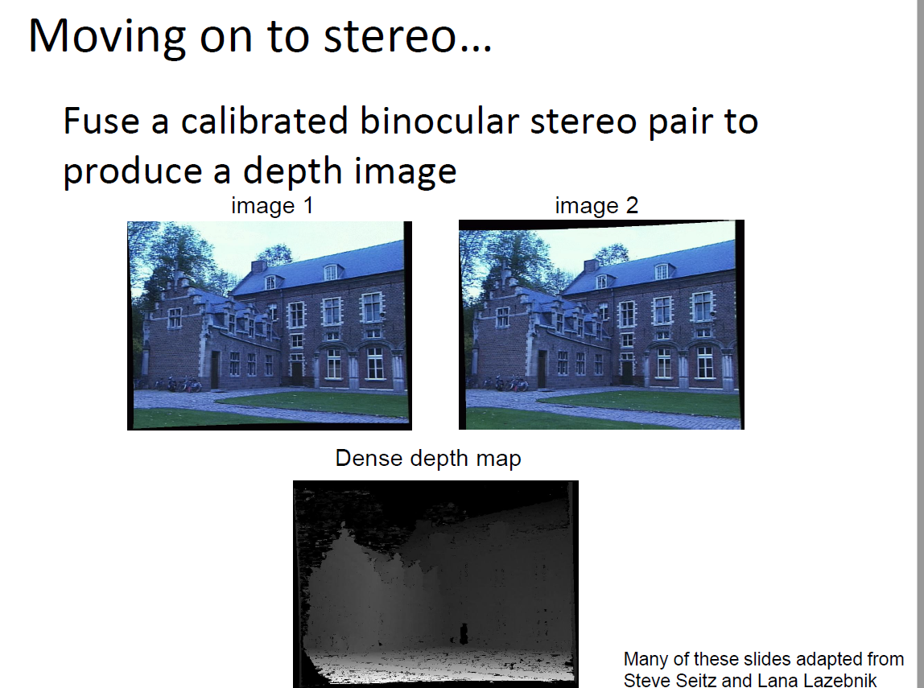

Slide 19
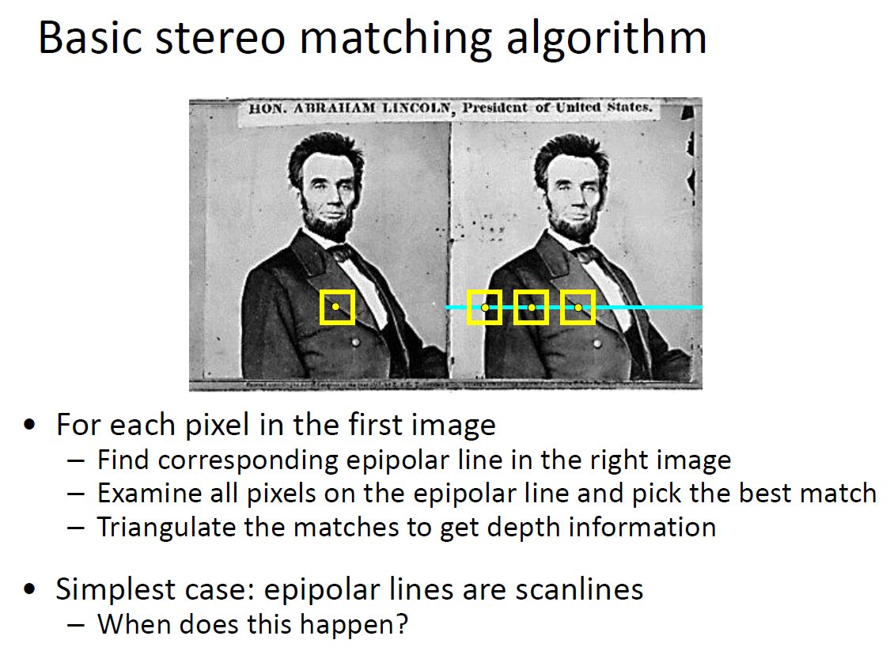

Slide 20
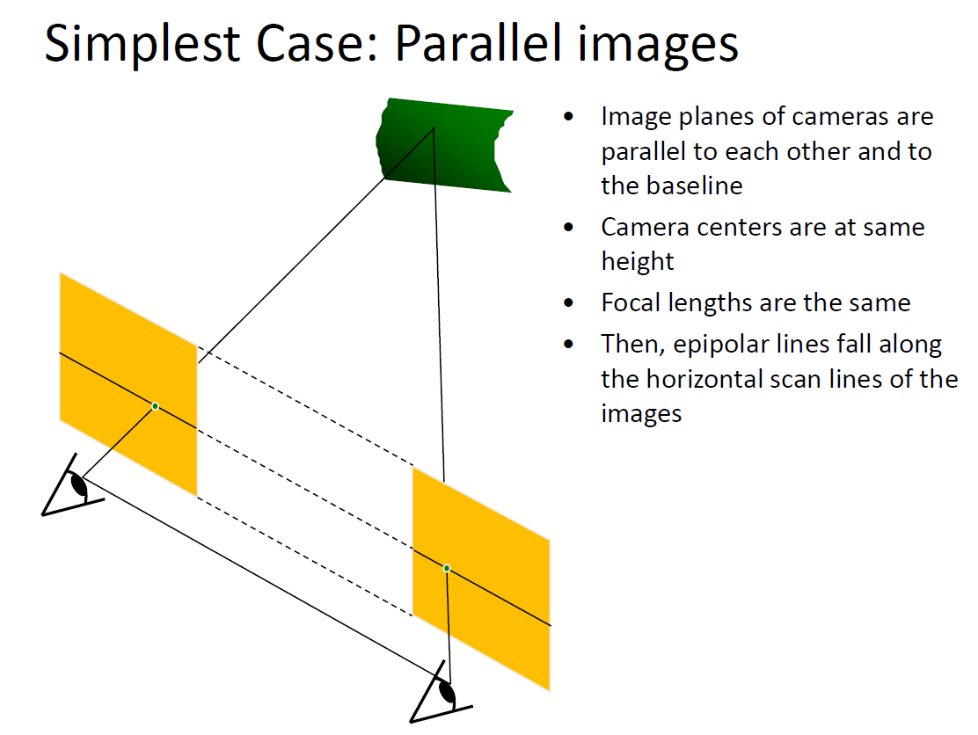

Slide 21
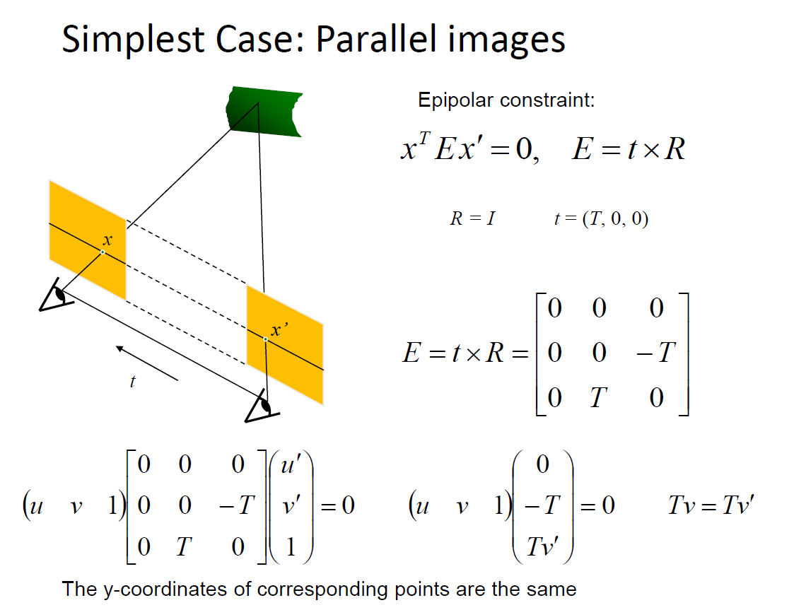

Slide 22
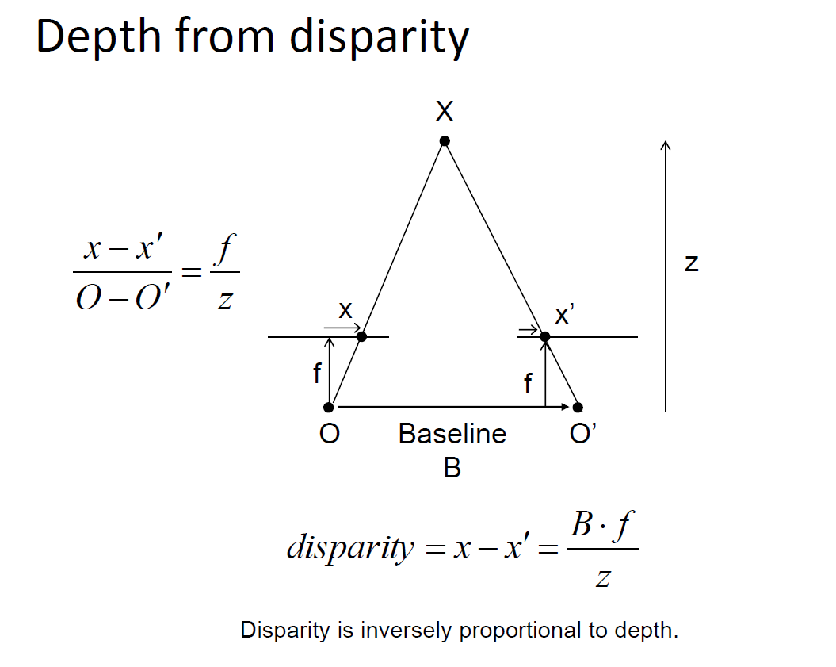

Slide 23
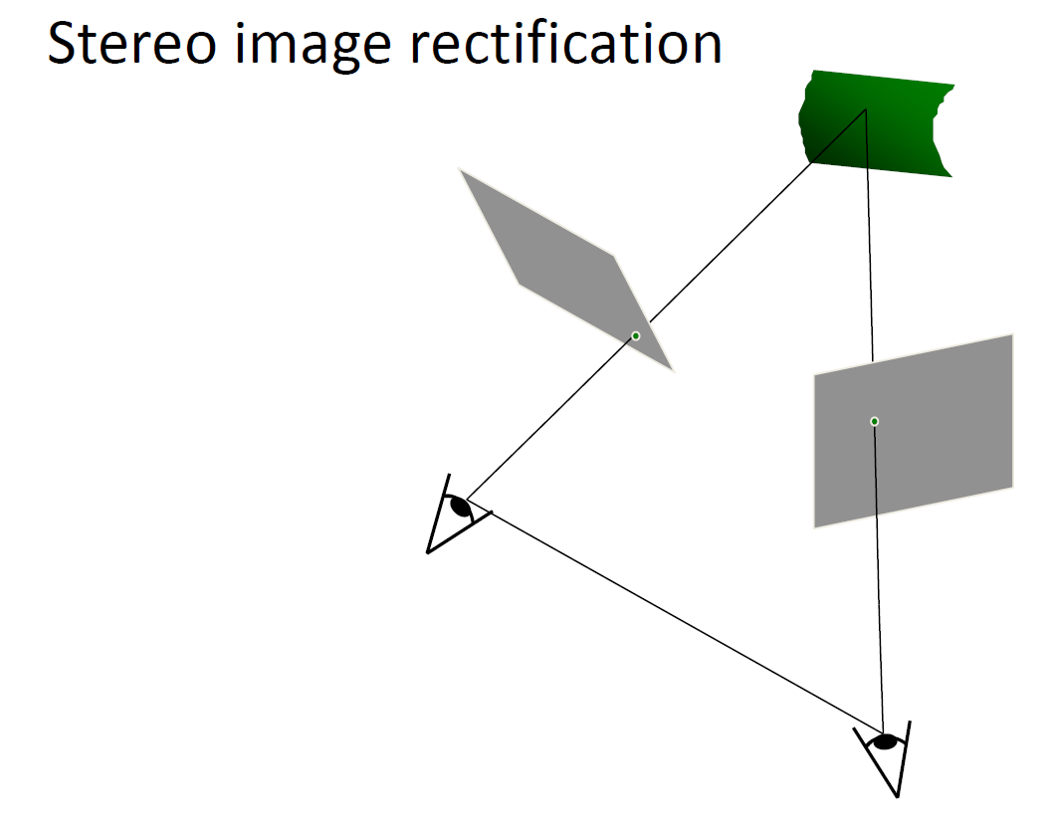

Slide 24
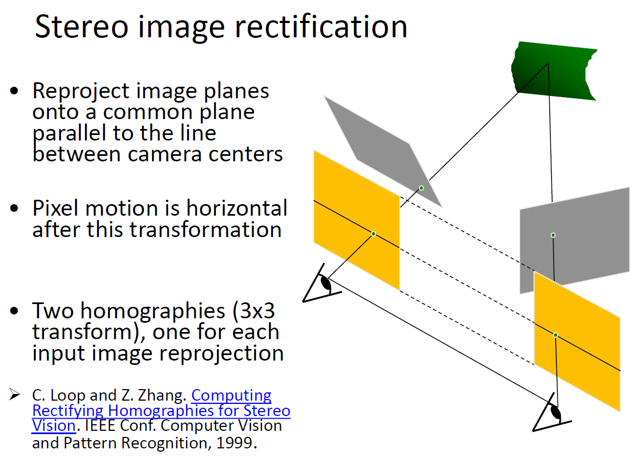

Slide 25
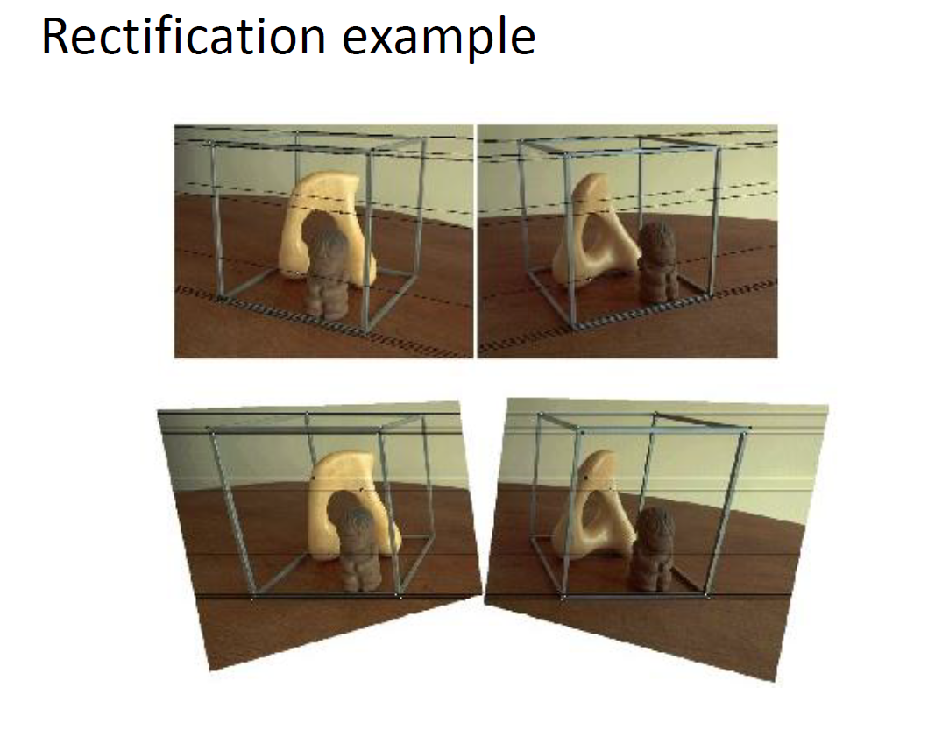

Slide 26
